Slide 1

POLLUTION’S

Slide 2
TYPES OF POLLUTION
AIR POLLUTION
WATER POLLUTION
SOIL POLLUTION
RADIOACTIVE POLLUTION
NOISE POLLUTION
LIGHT POLLUTION
THERMAL POLLUTION

Slide 3
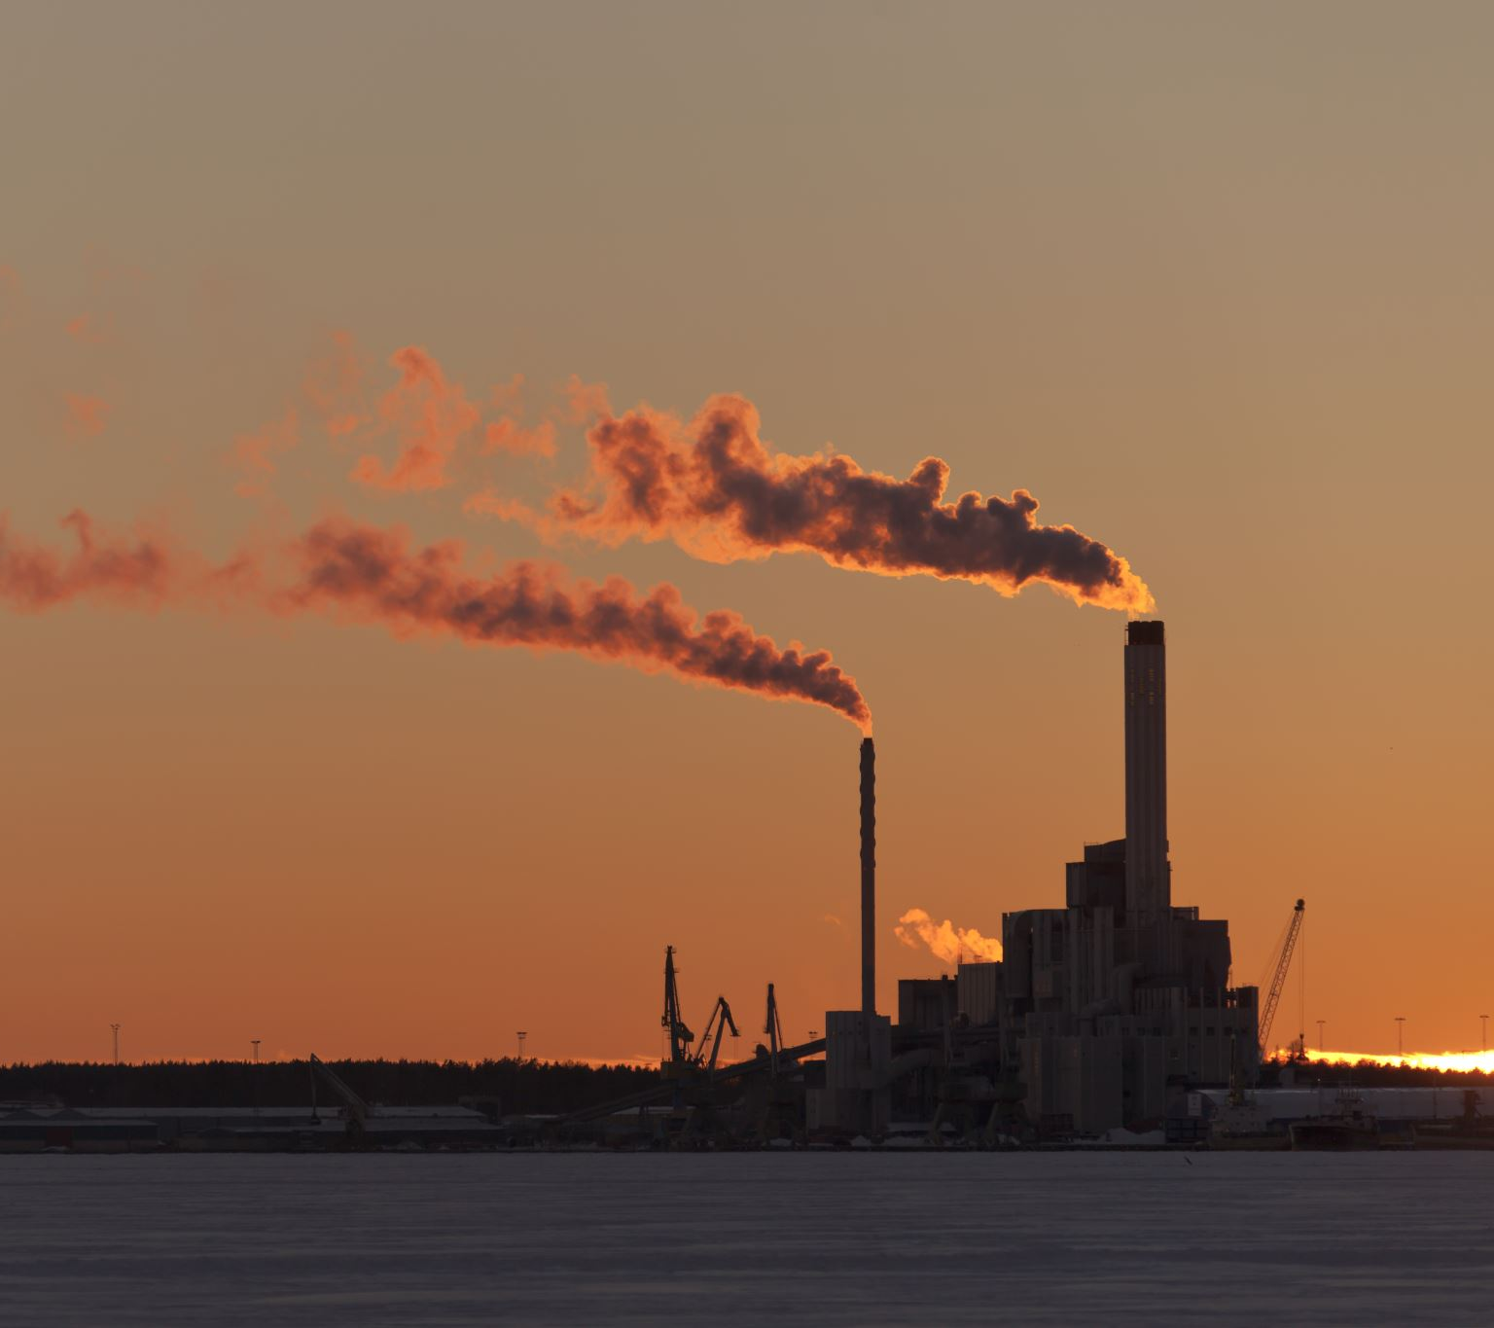
AIR POLLUTION
Overview. Air pollution is contamination of the
indoor or outdoor environment by any chemical,
physical or biological agent that modifies the natural characteristics of the atmosphere. Household
combustion devices, motor vehicles, industrial
facilities and forest fires are common sources of
air pollution.

Slide 4
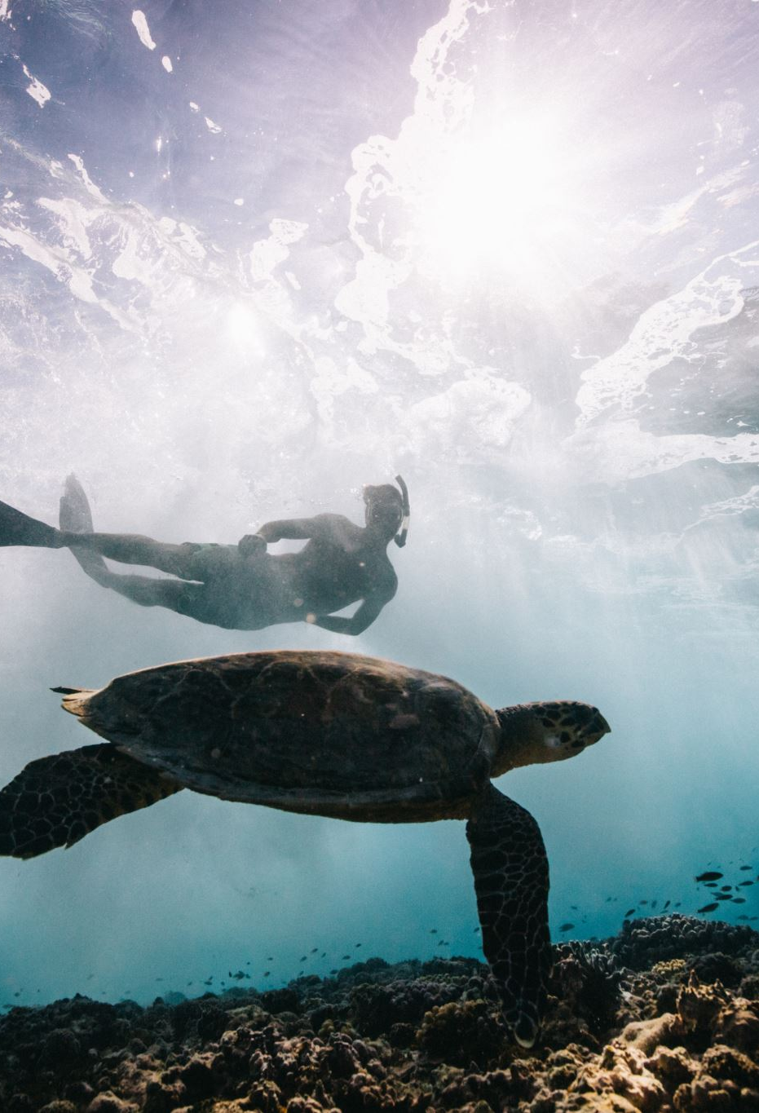
WATER POLLUTION
Water pollution may occur when waste water
is discharged into clean bodies without under going
proper treatment to nullify the effects of lethal chemical
at times people consume this water and it leads
to various water-borne diseases such as typhoid and chole .

Slide 5
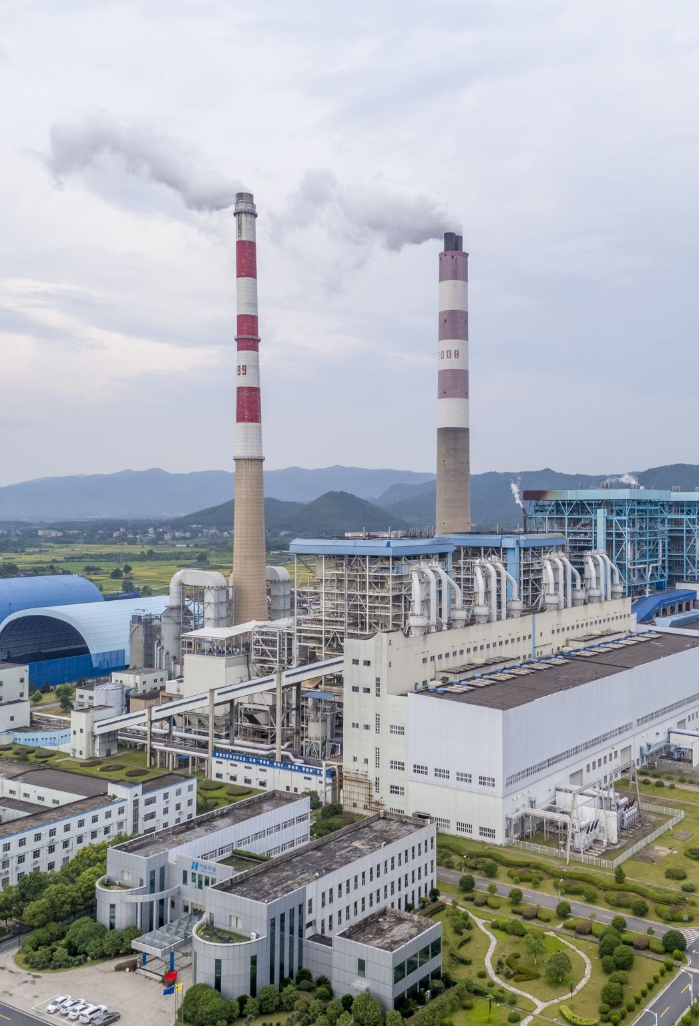
SOIL POLLUTION
Soil pollution refer to the contaminations of soil with anomalous concentrations of toxic substances . It is a serious environmental – concern since it harbors many health hazards .
For example – exposure to soil containing high concentrations of benzene increases risk of contracting leukemia .

Slide 6

NOISE POLLUTIONS
Noise pollution, or sound pollution, is the propagation
of noise or sound with ranging impacts on the activity
of human or animal life, most of which are harmful to a
degree. The source of outdoor noise worldwide is mainly
caused by machines, transport and propagation systems.

Slide 7

LIGHT POLLUTIONS
Light pollution is the human-made alteration of outdoor light levels from those occurring naturally. When we over-light, fail to use timers and sensors, or use the wrong color of light, we can negatively affect many parts of our world, including migratory birds, pollinators, sea turtles, and mammals, including humans.

Slide 8
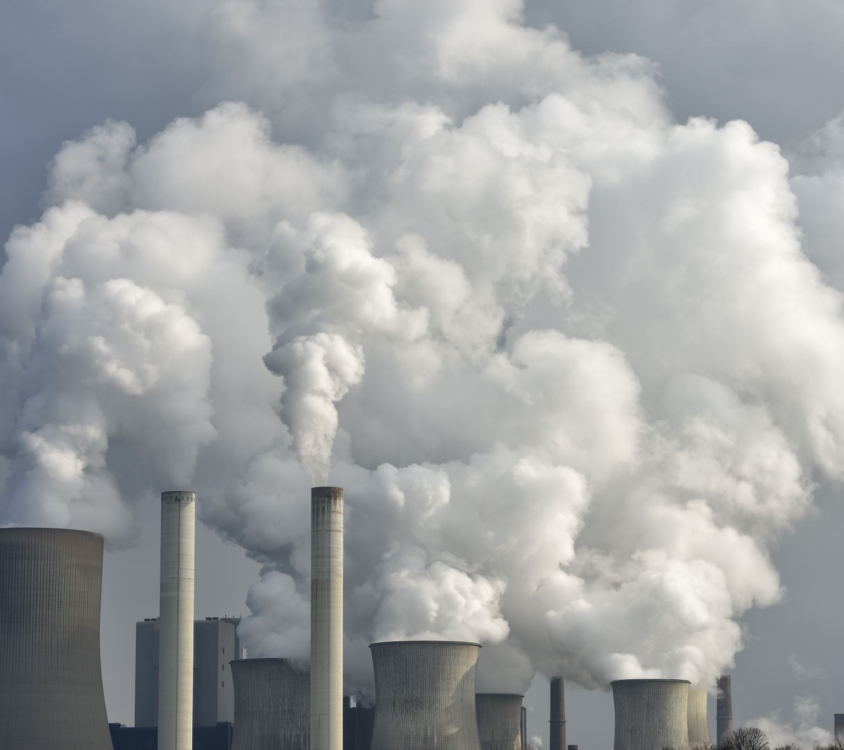
RADIOACTIVE POLLUTION
Radioactive pollution is defined as a form of physical, nuclear pollution to living organisms and the environment (hydrosphere, lithosphere, and atmosphere) arising from exposure to the release of ionizing radiation from radioactive elements such as uranium.

Slide 9
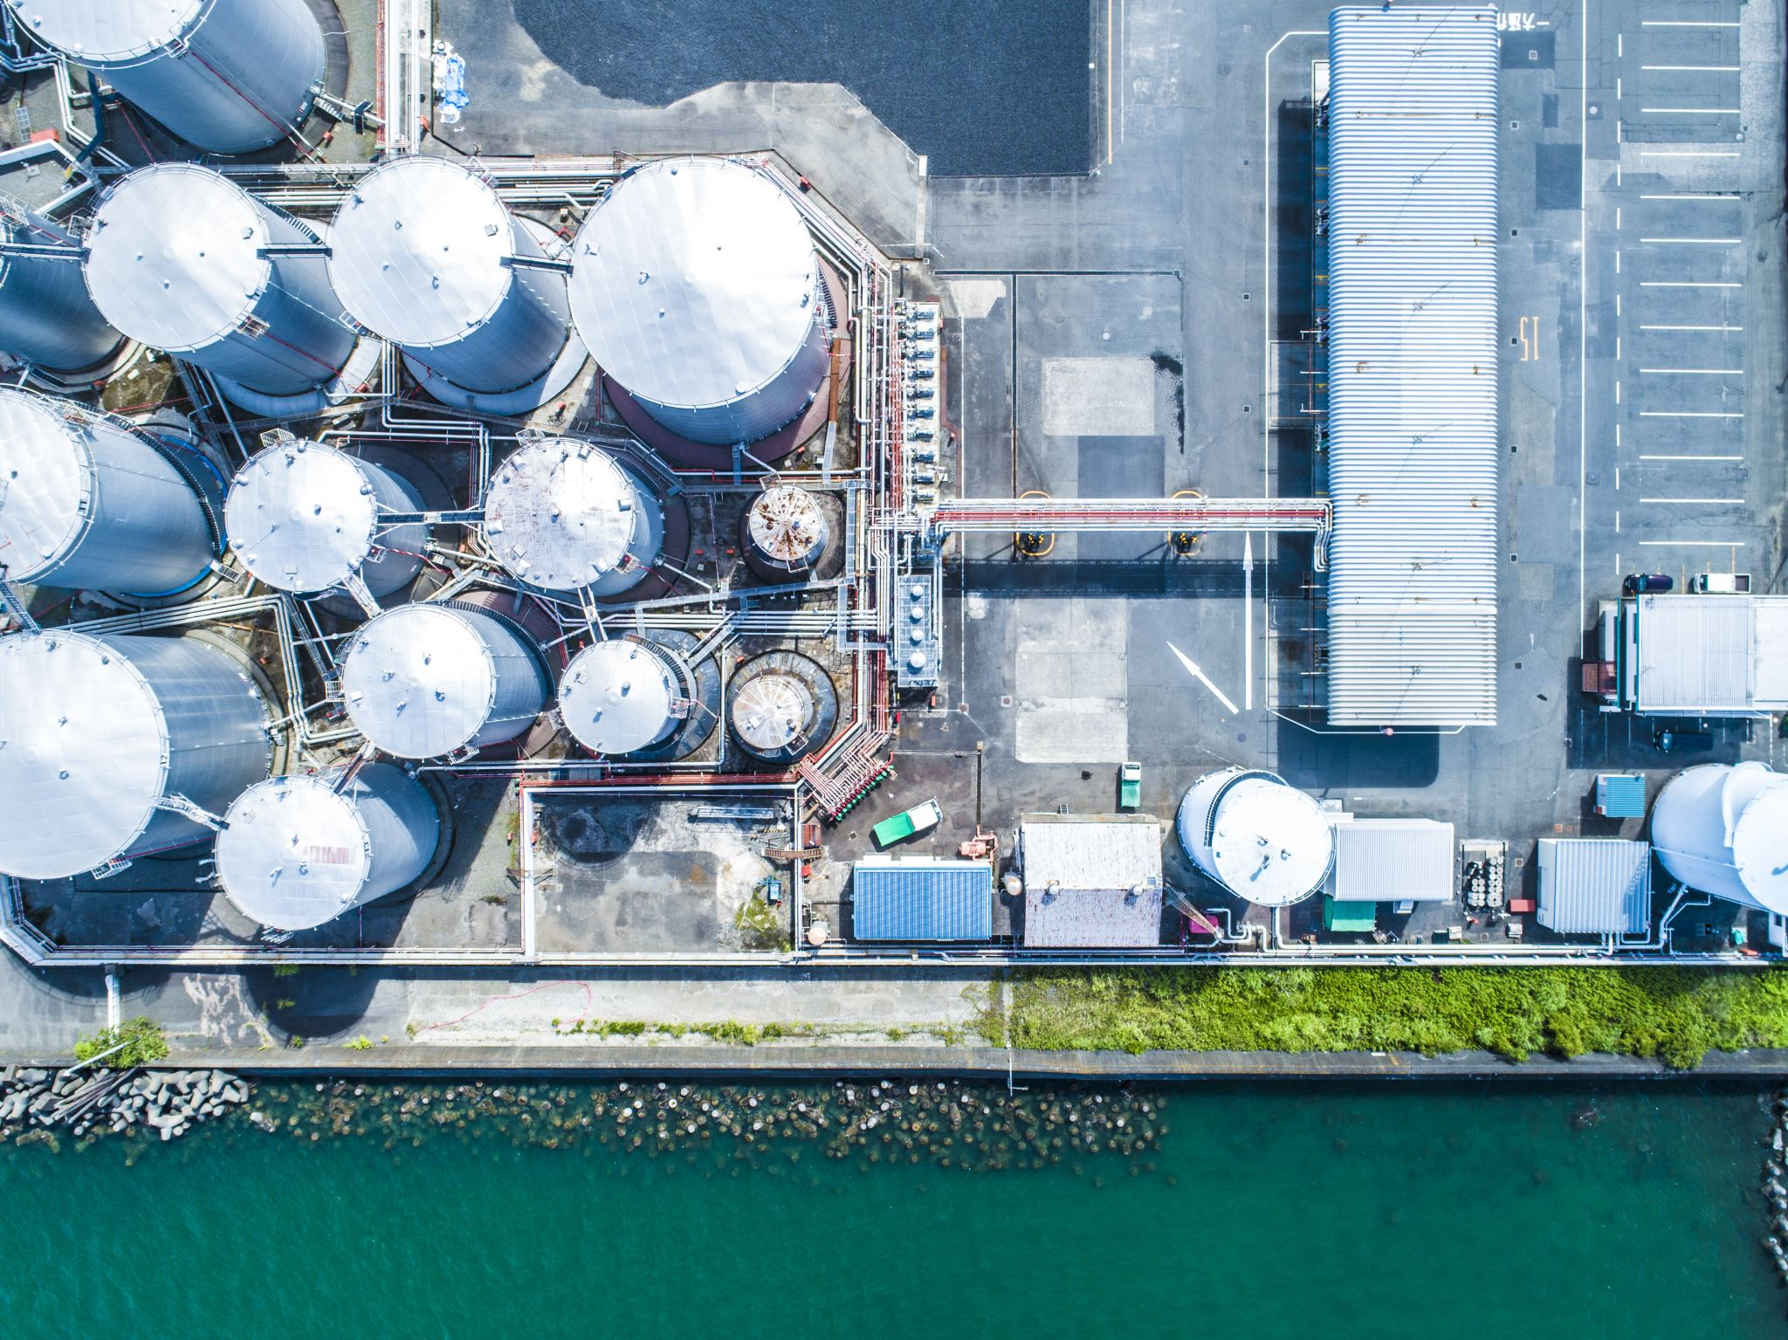
THERMAL POLLUTION
Thermal pollution can be controlled by passing the heated water through a cooling pond or a cooling tower after it leaves the condenser. One method is to construct a large shallow pond. Hot water is pumped into one end of pond and cooler water is removed from the other end.

